Slide 1

VIRTUAL ASSISTANT WITH SENTIMENT ANALYSIS
BY:
SAFOORA MASOOD 1604-19-737-007
SADIA AFREEN 1604-19-737-010

Slide 2
OUTLINE
Introduction
Problem Statement
Existing System
Disadvantages of Existing System
Proposed System
Working of Proposed System
Architecture
Modules
Code
Output
Conclusion
Future Enhancements
Reference

Slide 3

INTRODUCITON
A virtual assistant is an application that understands voice commands and completes tasks for a user.
Virtual assistants like these can do everything from answer questions, tell jokes, play music, and control items in your home such as lights, thermostats, door locks, and smart home devices. They can respond to many voice commands, send text messages, make phone calls, and set up reminders. Anything you do on your phone, you can probably ask your virtual assistant to do for you.

Slide 4
As these voice assistants are using Artificial Intelligence hence the result that they are providing are highly accurate and efficient. These assistants can help to reduce human effort and consumes time while performing any task, they removed the concept of typing completely and behave as another individual to whom we are talking and asking to perform task.
Jarvis draws its inspiration from Virtual assistants like Cortana for Windows and Siri for iOS. Users can interact with the assistant either through voice commands or keyboard input.
The IDE used in this project is Visual Studio Code. All the python files were created in VSCode and all the necessary packages were easily installable in this IDE. For this project following modules and libraries were used i.e. pyttsx3, SpeechRecognition, datetime, Wikipedia, Smtplib, pywhatkit, pyjokes, etc.
Functionalities of this project include, It can send emails, It can send text on WhatsApp, It can open command prompt, your favorite IDE, notepad etc., It can play music, It can do Wikipedia searches for you, It can open websites like Google, YouTube, etc., in a web browser, It can give weather forecast, It can give desktop reminders of your choice. It can have some basic conversation.

Slide 5
Problem Statement
We are all well aware about Cortana, Siri, Google Assistant and many other virtual assistants which are designed to aid the tasks of users in Windows, Android and iOS platforms. But to our surprise, there’s no such virtual assistant available for the paradise of Developers i.e. Linux platform. This Software aims at developing a personal assistant for Linux-based systems. The main purpose of the software is to perform the tasks of the user at certain commands, provided in either of the ways, speech or text. It will ease most of the work of the user as a complete task can be done on a single command. Jarvis draws its inspiration from Virtual assistants like Cortana for Windows and Siri for iOS. Users can interact with the assistant either through voice commands or keyboard input.

Slide 6
EXISTING SYSTEM
We are familiar with many existing voice assistants like Alexa, Siri, Google Assistant, Cortana which uses concept of language processing, and voice recognition. They listen the command given by the user as per their requirements and performs that specific function in a very efficient and effective manner.
As these voice assistants are using Artificial Intelligence hence the result that they are providing are highly accurate and efficient. These assistants can help to reduce human effort and consumes time while performing any task, they removed the concept of typing completely and behave as another individual to whom we are talking and asking to perform task. These assistants are no less than a human assistant but we can say that they are more effective and efficient to perform any task. The algorithm used to make these assistant focuses on the time complexities and reduces time.

Slide 7
DISADVANTAGES WITH THE EXISTING SYSTEM
We are familiar with many existing voice assistants like Alexa, Siri, Google Assistant, Cortana which uses concept of language processing, and voice recognition. They listen the command given by the user as per their requirements and performs that specific function in a very efficient and effective manner.
As these voice assistants are using Artificial Intelligence hence the result that they are providing are highly accurate and efficient. These assistants can help to reduce human effort and consumes time while performing any task, they removed the concept of typing completely and behave as another individual to whom we are talking and asking to perform task. These assistants are no less than a human assistant but we can say that they are more effective and efficient to perform any task. The algorithm used to make these assistant focuses on the time complexities and reduces time.
But for using these assistants one should have an account (like Google account for Google assistant, Microsoft account for Cortana) and can use it with internet connection only because these assistants are going to work with internet connectivity. They are integrated with many devices like, phones, laptops, and speakers etc.

Slide 8
PROPOSED SYSTEM
It was an interesting task to make my own assistant. It became easier to send emails without typing any word, searching on Google without opening the browser and performing many other daily tasks like playing music, opening your favorite IDE with the help of a single voice command. Jarvis is different from other traditional voice assistants in terms that it is specific to desktop and user does not need to make account to use this, it does not require any internet connection while getting the instructions toper form any specific task. The IDE used in this project is Visual Studio Code. All the python files were created in VSCode and all the packages were easily installable in this IDE. For this project following modules and libraries were used i.e. pyttsx3, SpeechRecognition, datetime, Wikipedia, Smtplib, pywhatkit, pyjokes, etc.
I have created a live GUI for interacting with the JARVIS as it gives a design and interesting look while having the conversation. With the advancement JARVIS can perform any task with same effectiveness or can say more effectively than us. By making this project, I realized that the concept of AI in every field is decreasing human effort and saving time. Functionalities of this project include, It can send emails, It can send text on WhatsApp, It can open command prompt, your favorite IDE, notepad etc., It can play music, It can do Wikipedia searches for you, It can open websites like Google, YouTube, etc., in a web browser, It can give weather forecast, It can give desktop reminders of your choice. It can have some basic conversation.

Slide 9
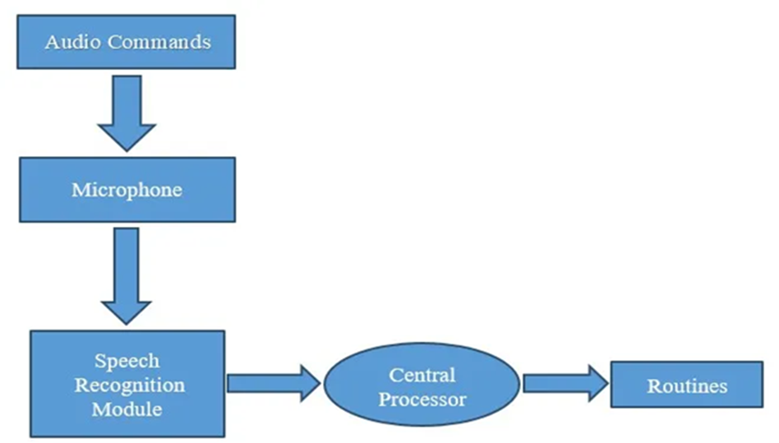
WORKING OF PROPOSED SYSTEM
The work started with analyzing the audio commands given by the user through the microphone. This can be anything like getting any information, operating a computer’s internal files, etc.

Slide 10
ARCHITECTURE
The architecture characterizes the system. User gives text or voice input. Voice commands are converted to text through Google speech API. Text input is simply stored in the database for further process. It is recognised and matched with the commands available in the database. Once the command is found, its respective task is executed as voice, text or through user interface as output. It can also be in the form of application execution.

Slide 11
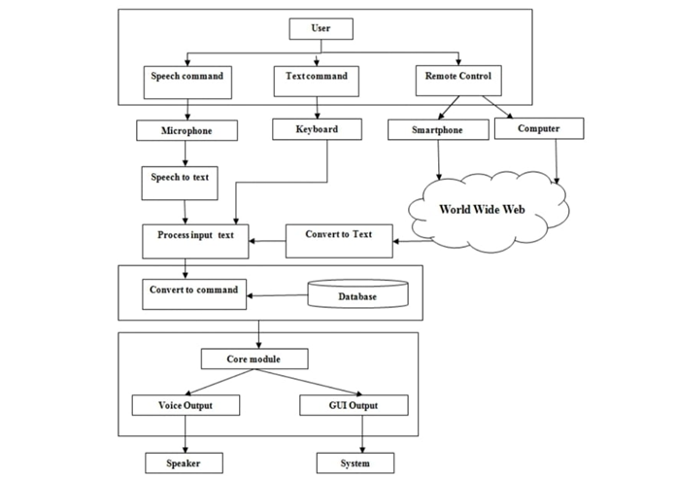

Slide 12
MODULES:
Speech Recognition module:
The system uses Google’s online speech recognition system for converting speech input to text. The speech input Users can obtain texts from the special corpora organized on the computer network server at the information centre from the microphone is temporarily stored in the system which is then sent to Google cloud for speech recognition. The equivalent text is then received and fed to the central processor.
Python Backend:
The python backend gets the output from the speech recognition module and then identifies whether the command or the speech output is an API Call and Context Extraction. The output is then sent back to the python backend to give the required output to the user.

Slide 13
API calls
API stands for Application Programming Interface. An API is a software intermediary that allows two applications to talk to each other. In other words, an API is a messenger that delivers your request to the provider that you’re requesting it from and then delivers the response back to you.
Content Extraction
Context extraction (CE) is the task of automatically extracting structured information from unstructured and/or semi-structured machine-readable documents. In most cases, this activity concerns processing human language texts using natural language processing (NLP)..
Text-to-speech module
Text-to-Speech (TTS) refers to the ability of computers to read text aloud. A TTS Engine converts written text to a phonemic representation, then converts the phonemic representation to waveforms that can be output as sound. TTS engines with different languages, dialects and specialized vocabularies are available through third-party publishers.

Slide 15
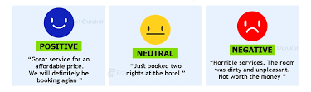
SENTIMENT ANALYSIS
Sentiment analysis is the act of using NLP to help us understand the opinion of the public in a particular context in natural language.
The evolution in NLP has been remarkable because we now have tools and packages that make solving problems with NLP very easy. One of those tools is Textblob.
Textblob is a Python NLP library that uses a natural language toolkit (NLTK). It uses NLTK because it is simple, easy to deploy, will use up fewer resources, gives dependency parsing, and can be used even for small applications.
Textblob can be used for complex analysis and working with textual data. When a sentence is passed into Textblob it gives polarity Polarity is the output that lies between [-1,1], where -1 refers to negative sentiment and +1 refers to positive sentiment.

Slide 16

CONCLUSION
Virtual Personal Assistants are a very
effective way to organize your program.
There are now many Smart Personal
Digital Assistant apps available on the
market for various device platforms.
JARVIS is a very helpful voice assistant without any doubt as it saves time of the user by conversational interactions, its effectiveness and efficiency. But while working on this project, there were some limitations encountered and also realized some scope of enhancement in the future which are mentioned below:
LIMITATIONS
Security is somewhere an issue, there is no voice command encryption in this project.
Background voice can interfere
Misinterpretation because of accents and may cause inaccurate results.
!

Slide 17
FUTURE SCOPE:
We aim to make this project a complete server assistant and make it smart enough to act as a replacement for a general server administration. The future plans include integrating Jarvis with mobile using React Native to provide a synchronized experience between the two connected devices. Further, in the long run, Jarvis is planned to feature auto deployment supporting elastic beanstalk, backup files, and all operations which a general Server Administrator does.
The next step will be to remove as much hardware as possible. With the ingenuity of the VA present in the clouds, being pulled in, and pushing its way into our lives with many devices in our bodies and our offices, homes, and cars. Your VA will always tell you about suggestions and take orders, and you will know more about yourself than you know yourself. We can expect this device to be installed and permanent.

Slide 18
REFERENCES
· https://codewithharry.com/videos/python-tutorials-for-absolute-beginners-120
· https://easychair.org/publications/preprint_open/j2GR
· https://www.freecodecamp.org/news/python-project-how-to-build-your-own-jarvis-using-python/
· https://extrudesign.com/virtual-assistant-using-python/
· https://www.youtube.com/watch?v=Lp9Ftuq2sVI&t=1708s

Slide 19
THANK YOU

